Slide 1
Display Software Architecture
Overview & Training

Slide 2
Platform & Application Overview
7 Different Platforms
  Advisor, Messenger, MIDS, GeneSys
40+ Programs
  BHL-E, Monarch MG, MWL H2, Ph4 TTT, Century, GeneSys L0-L3, Challenger, etc.

Slide 3
Our Platforms
MIDS (Advisor 6.0 m1)
  320x240 LCD, Minimal I/O, external keypad
  In Production – Maintenance Only
Advisor (Advisor 6.0 m2)
  320x240 LCD, Several I/O capabilities, Onboard keypads, etc.
  In Production
Messenger
  240x64 LCD, Minimal I/O, Onboard keypad, etc.
  In Production
GeneSys (4 Platforms)
  132x33 → 320x240 LCD’s (Product not under our design control)
  Soon to be In Production

Slide 4
Display Application History
2000 – MIDS
  Challenger Ag Tractor
  Gas Engines
Early 2002 – Advisor
  Phase 4 TTT
  E-Series BHL
Late 2002 – Messenger
  On Highway Truck Cat ID Replacement
Early 2003 – GeneSys L0-L2
  3 GenSet Applications
Late 2003
  5+ New Applications for Messenger and Advisor
2004
  25+ Applications across all Displays
Late 2004 - GeneSys L3
  A4 Platform
2005
  40+ Applications

Slide 5
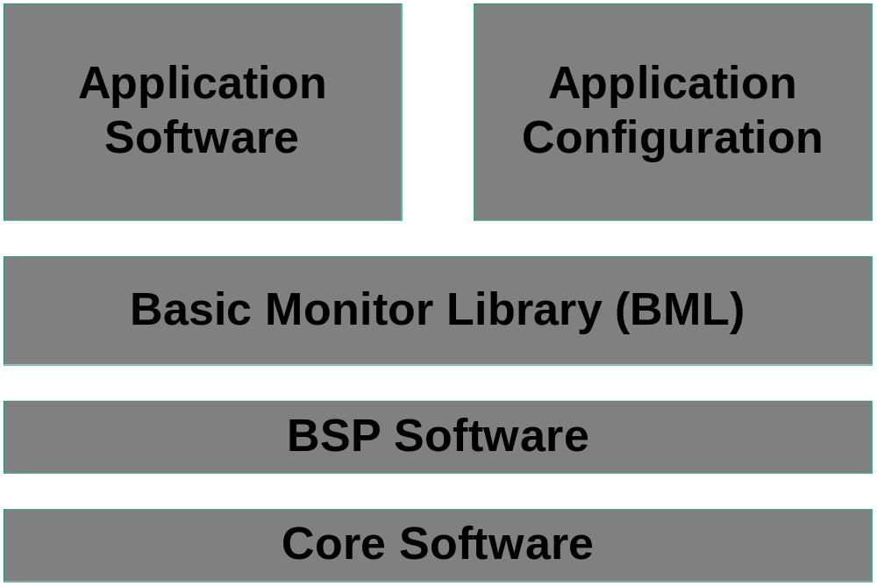
Basic Architecture

Slide 6
Basic Monitor Library (BML)
45+ Feature Based Components
  Output Drivers, Event Database, Graphics, External Keypad, Data Link Protocols, User Interface, etc.
Components are Platform and Application Independent
  Configuration Drives Usage and Performance
No Inter-Component Dependencies*
  Feature Mix and Match
Common Architecture
  Data is accessed through each component through a common set of 8 specific prototypes

Slide 7
Platform Software
4 Separate, yet Similar VOBS
  MIDS → Advisor → Messenger → GeneSys
Handle Board Interfaces (BSP)
  Provides board and data link, initialization, etc.
Provides Common Interface for Accessing Data
  Uses the BML Common Architecture to provide the gateway for all data
Handles Task Creation and Monitoring
Flash Files are Created in this VOB

Slide 8
Application Configuration
1 VOB – 40+ Application Folders
  Flash File Uniqueness
Contains Items Unique to a Specific Application
  Screen Definitions
  Strings
  Parameter Tables
Flash Files / Deliverables are Stored in this VOB
Config Files are Strikingly Similar Across Platform and Applications
  “If you’ve seen one config, you’ve seen them all.”
  Exceptions
    GeneSys – Interface to Control Side Software
    Hydraforce – Caterpillar Screen Builder Tool (CSBT) Configuration

Slide 9
Software Re-Usability
Solid Component Architecture and Design
  At Least 7 Years
  At Least 7 Platforms
  At Least 40 Applications
Inflexible?
  One Feature/One Customer Affects All Programs

Slide 10
External Uses of BML
Machine Application Software
  Dash Cluster Software
  Event Gathering
  Calibrations
PCS 3.0
  Data Transfer
VIMS
  Event Gathering and Reporting
  Data Transfer

Slide 11
Future Software Enhancements
Correct Feature Design
  Prevents Wheel Re-Invention
  Can Satisfy Multiple Customers at Once
BML Design
  Must encompass multiple and future platforms
Application Design
  Must encompass multiple and future programs

